Slide 1
Minix Setup

Slide 2
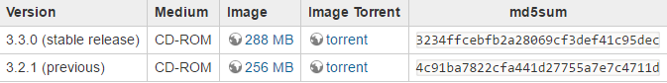
Minix Installation
Minix download: http://wiki.minix3.org/doku.php?id=www:download:start
Virtualbox download: https://www.virtualbox.org/wiki/Downloads

Slide 3
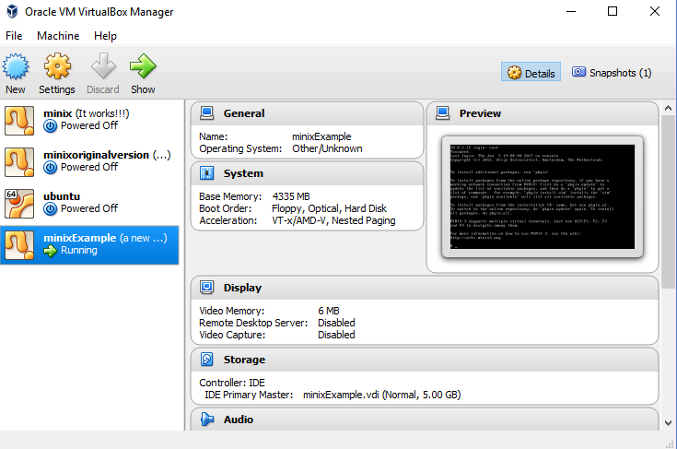
Minix Installation
Open up VirtualBox and click New

Slide 4
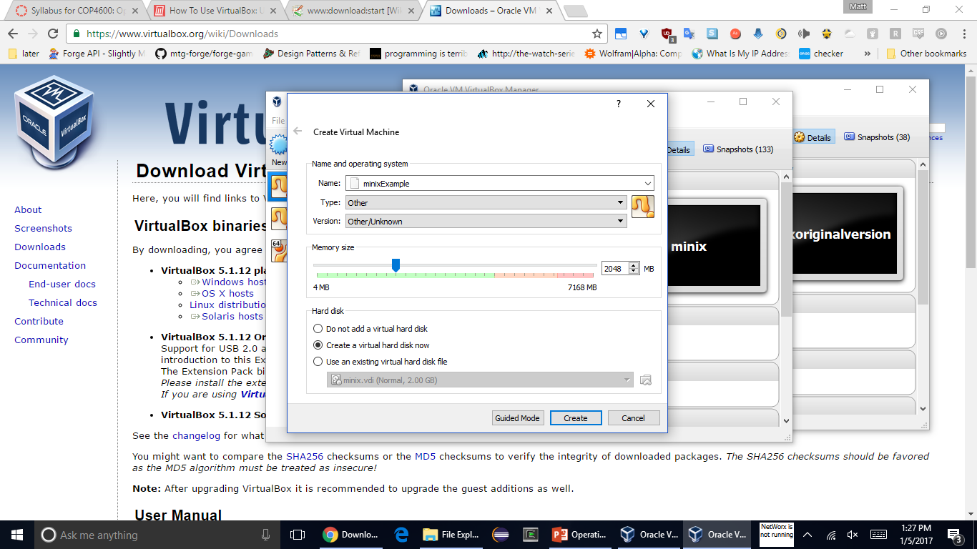
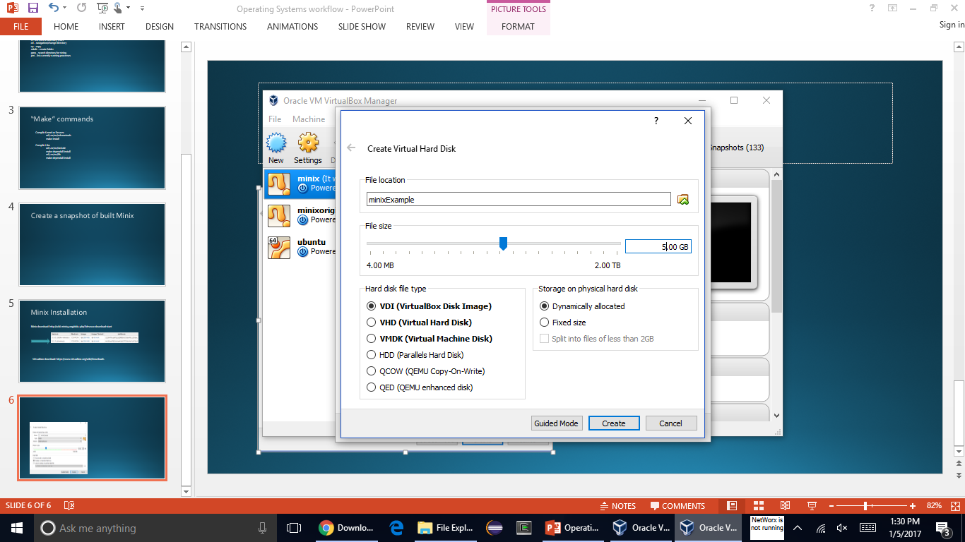
Minix Installation
Assign as much ram as you want. If you assign too little, compilation will take forever. This can be changed later in settings
Assign a few gigs for total storage size

Slide 5
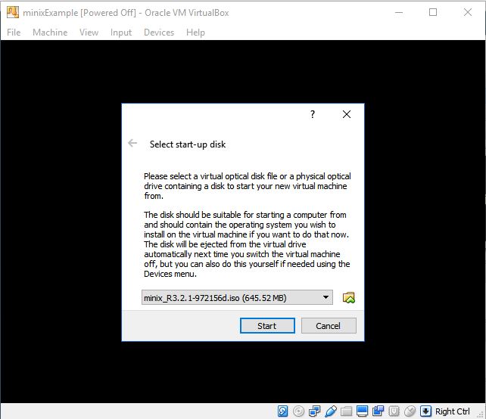
Minix Installation
Start the VM and select the minix 3.2.1 iso file

Slide 6
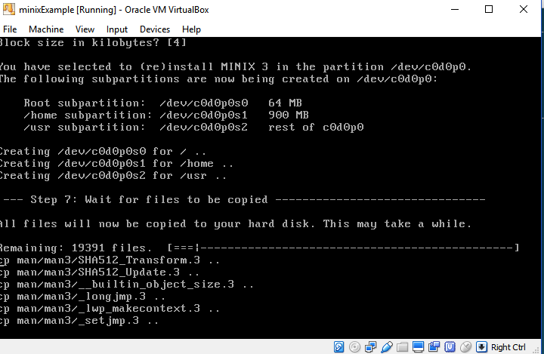
Minix Installation
Follow the setup instructions, then on Step 7 it will install

Slide 7
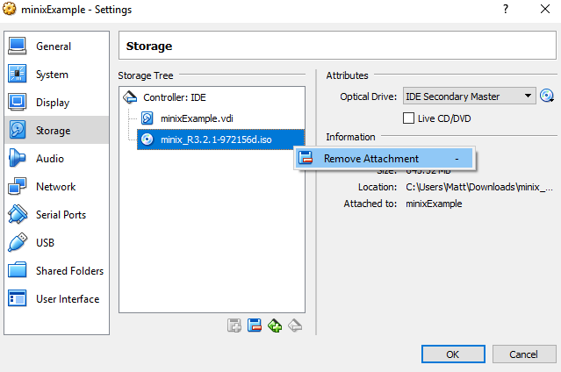
Minix Installation
Go to settings and remove the disk image before booting again

Slide 8
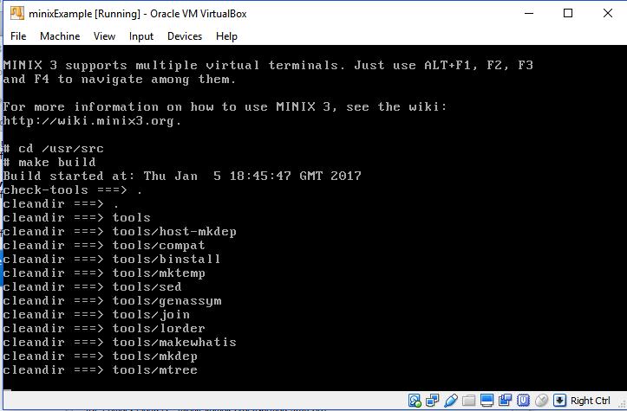
Minix Installation
This will take 15-20 minutes.
Afterwards, reboot and take a snapshot.
Build system with:
‘cd /usr/src’
‘make build’

Slide 9
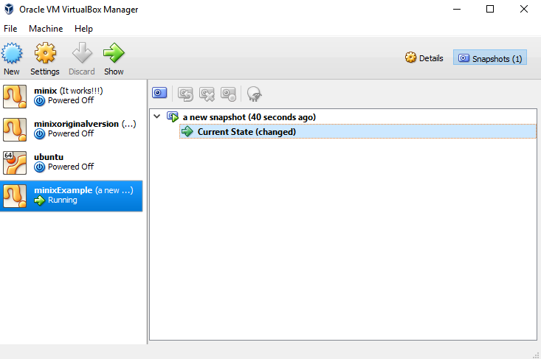
Snapshots

Slide 10
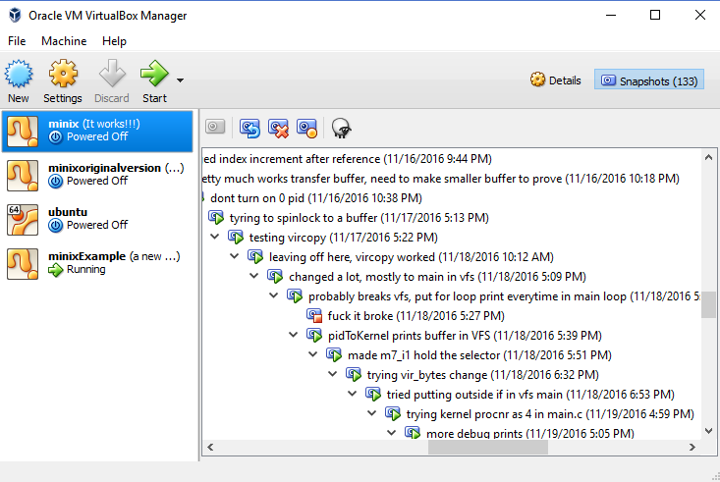
Snapshots
Typical workflow should be:
make changes to server/kernel/library
compile
take a snapshot
reboot.
Sometimes a change will break the system and you won’t be able to boot or access your files, aka if you don’t have a snapshot you have to start over.

Slide 11
Openssh
For windows:
Type in minix:
‘pkgin update’
‘pkgin install openssh’
Then set a password with:
‘passwd’
Then ‘reboot’

Slide 12
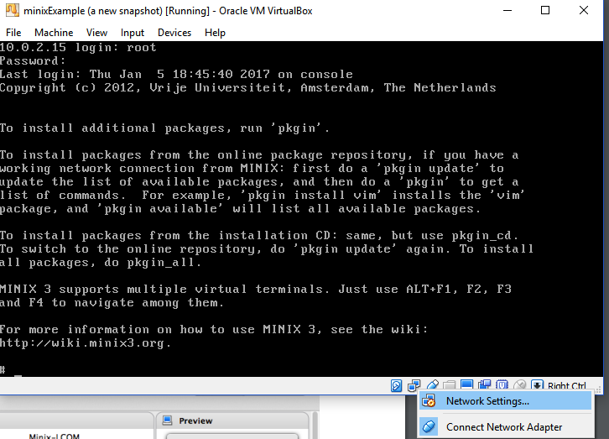
Openssh
Open up Network Settings

Slide 13
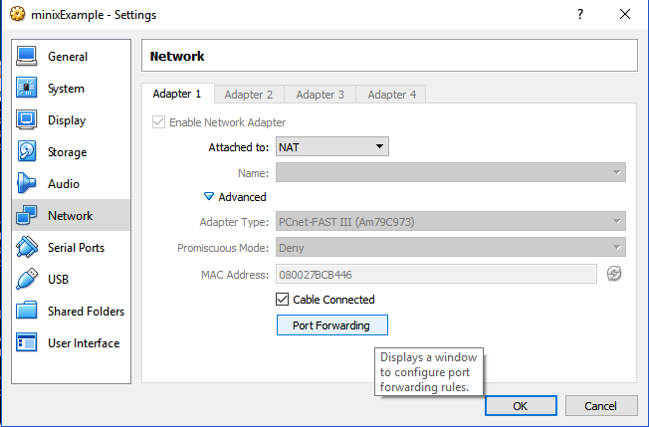
Openssh
Click Advanced, then Port Forwarding

Slide 14
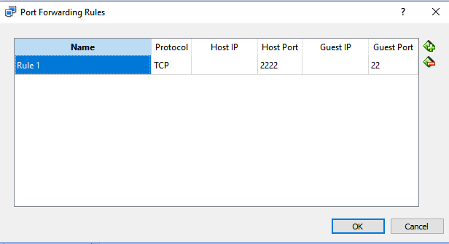
Openssh

Slide 15
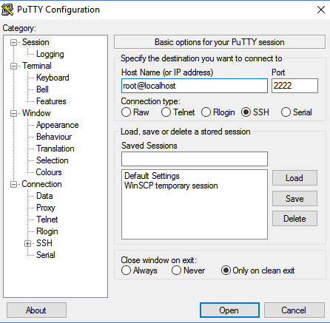
PuTTY
Download PuTTY from: http://www.chiark.greenend.org.uk/~sgtatham/putty/download.html
This will be necessary for debugging, the minix terminal doesn’t let you scroll up.

Slide 16
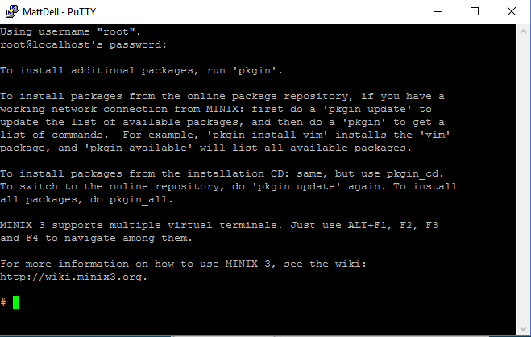
PuTTY
This will be an identical terminal to the one in Virtualbox, though after compiling code you’ll actually be able to scroll up and see errors.

Slide 17
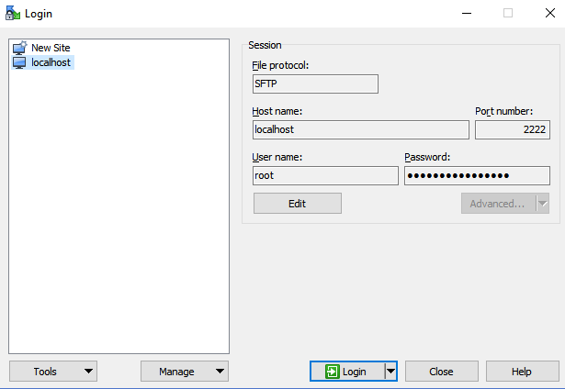
WinSCP
WinSCP download here:
https://winscp.net/eng/download.php

Slide 18
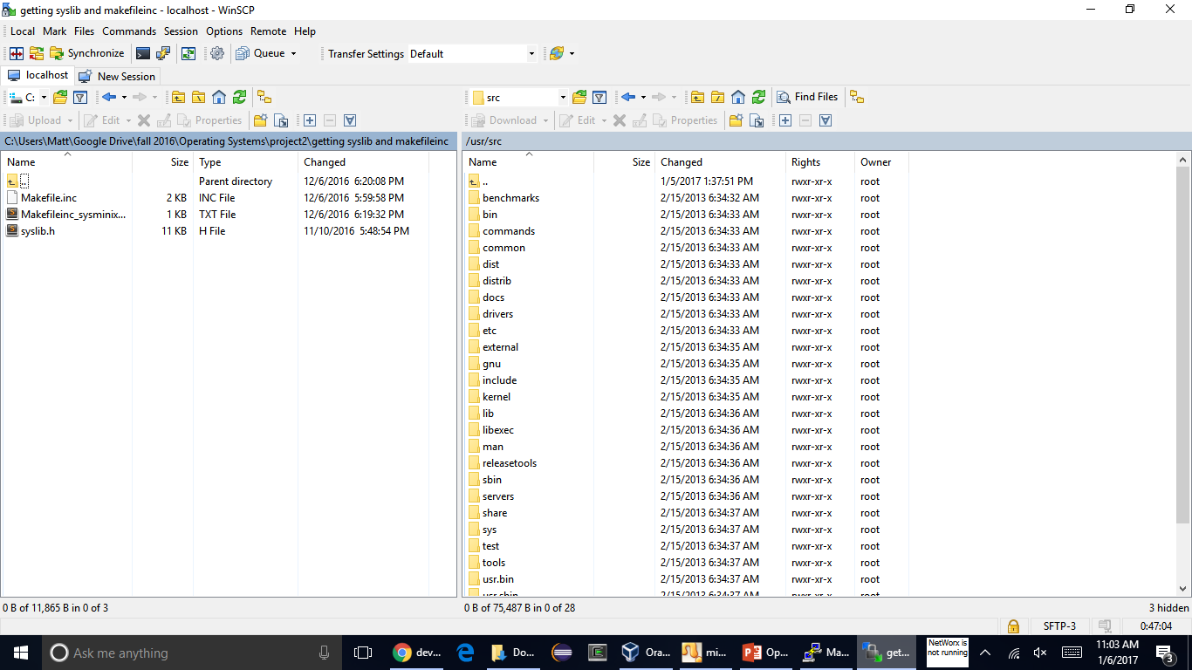
WinSCP

Slide 19
For Mac (alternatives)
You can use FTP for file transfer: http://www.mcs.csueastbay.edu/~tebo/Classes/6560/minix-file-transfer.html
You can use Filezilla or Cyberduck, though they aren’t as good as WinSCP

Slide 20
As a last resort for file transfer:
Shared Folders: http://wiki.minix3.org/doku.php?id=usersguide:runningonvirtualbox
To use the shared folders feature please do the following:
Ensure the virtual machine is currently off;
Go to the Settings of the virtual machine;
Go to the Shared Folders tab;
Click the add button and select the folder to share from the host and assign it a name;
Click on OK to save the change;
Start the VM and login;
To mount your shared folder do the following:
‘mount -t vbfs -o share=NAME none /mnt’
Be sure to replace NAME here with the name you assigned the share in step 4.

